Slide 1

Leverage JSON in SQL Server
JSON data in Microsoft SQL Server
https://github.com/db-berater/Leverage-JSON-in-SQL-Server

Slide 2

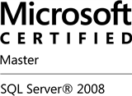


Uwe Ricken db Berater GmbH
I am working with IT-systems since early 1990's and with the main focus on Microsoft SQL Server since version 6.0. I started with development of database applications in 1998 with a professional CRM-System based on Microsoft products (Microsoft Office and Microsoft SQL Server).
Since 2008 I'm focused exclusively on Microsoft SQL Server and I was working in 3rd level support teams for enterprise companies, banks and insurances.
Since May 2013 I'm a Microsoft Certified Master: SQL Server 2008 which was an amazing way into the depth of Microsoft SQL Server.
In July 2013 I have been awarded with the MVP Award for Microsoft SQL Server.
www: http://www.db-berater.de
email: uwe.ricken@db-berater.de
blog: http://www.sqlmaster.de
LinkedIn: https://www.linkedin.com/in/uwericken

Slide 3
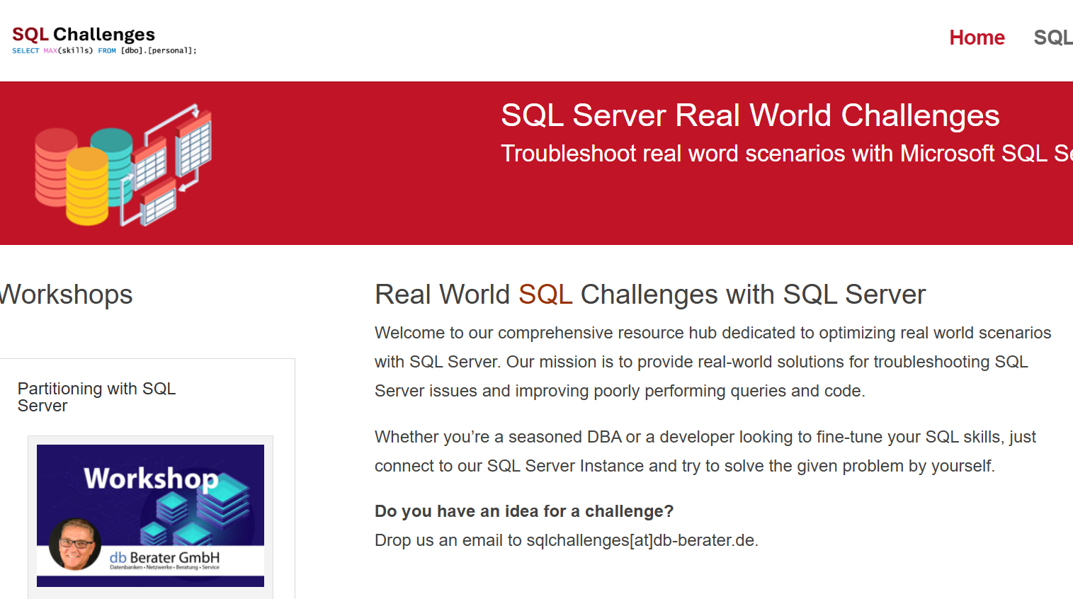
Challenge SQL Server real world scenarios
Get a challenge at least once a month
Connect to a provided SQL Server Instance
Load the challenge scenario
Try to solve it
Blog about your solution
Leave a link in the comments of the challenge to your blog post.
https://sqlchallenges.de

Slide 4
Agenda
What is JSON?
JSON structure
Object
Array
JSON Data Types
String, Number, „true“, „false“, „null“
JSON Functions
Indexing for Performance
Integration with T-SQL
Real World Use Case

Slide 5
Working with JSON in SQL-Server
JSON (JavaScript Object Notation) is a lightweight data-interchange format.
It is language-independent, easy to understand, and self-describing.
JSON is a trendy data interchange format nowadays.
Most modern api services return the data in JSON text.
JSON is one of the needs for data developers to return JSON in SQL Server.

Slide 6
JSON in SQL Server
The Built-in JSON support in the SQL server is different from the native JSON type.
JSON will be represented as an NVARCHAR type for the following reasons.
Cross feature compatibility
The data type NVARCHAR has supported all the SQL server components such as Hekaton, temporal, column store tables, etc. It works with almost all the features of SQL Server.
Migration
Before SQL Server, developers stored JSON in the database as text. They needed to change the database schema and migrate the data into a new feature if JSON type was introduced.
Client-side support
Currently, there is no standardized JSON object type on the client side. JSON is treated as “Object” in JavaScript.

Slide 7
JSON data type in future versions…
The JSON data type is currently in preview for Azure SQL Database and Azure SQL Managed Instance configured with the Always-up-to-date update policy.
The JSON type provides the following benefits over storing JSON data in varchar or nvarchar:
More efficient reads, as the document is already parsed
More efficient writes, as the query can update individual values without accessing the entire document
More efficient storage, optimized for compression
No change in compatibility with existing code
The JSON type internally stores data using UTF-8 encoding (Latin1_General_100_BIN2_UTF8)
This behavior matches the JSON specification.

Slide 8
JSON components

Slide 9
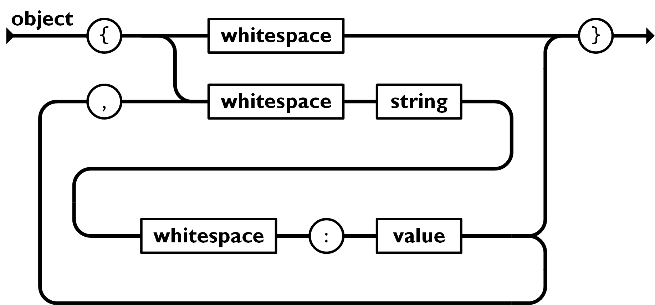
JSON – Object
An object is an unordered set of name/value pairs
An object begins with “{“ and ends with “}”.
Each name is followed by “:”
The name:value pairs are separated by a “,”
{
"first_name":"Uwe",
"last_name":"Ricken"
}
https://www.json.org/json-en.html

Slide 10
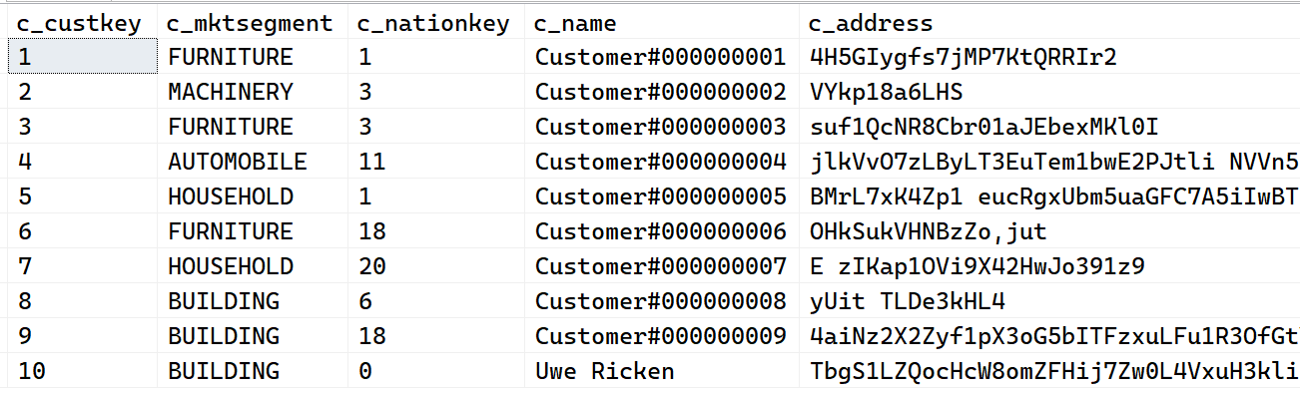
JSON - Object
{ "c_custkey": 10, "c_mktsegment": "Building", "c_nationkey": 0, "c_name": "Uwe Ricken", "c_address": "TbgS1LZQocHcW8omZFHi…", "c_phone": "532-332-4937", "c_acctbal": 6548.4, "c_comment": "slyly ironic asympto…"
}

Slide 11
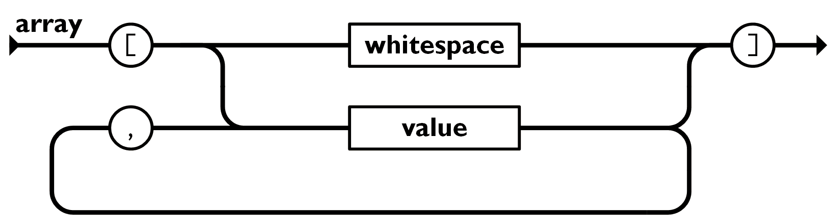
JSON - Array
An array is an ordered collection of values.
An array begins with “[“ and ends with “]”.
Values are separated by “,”.
[
{
"c_custkey": 10,
"c_mktsegment": "Building", ... "c_comment": "slyly ironic … ironic"
},
{
"c_custkey": 7,
"c_mktsegment": "Household", ...
"c_comment": "carefully regular … asymptotes."
}
]
https://www.json.org/json-en.html

Slide 12
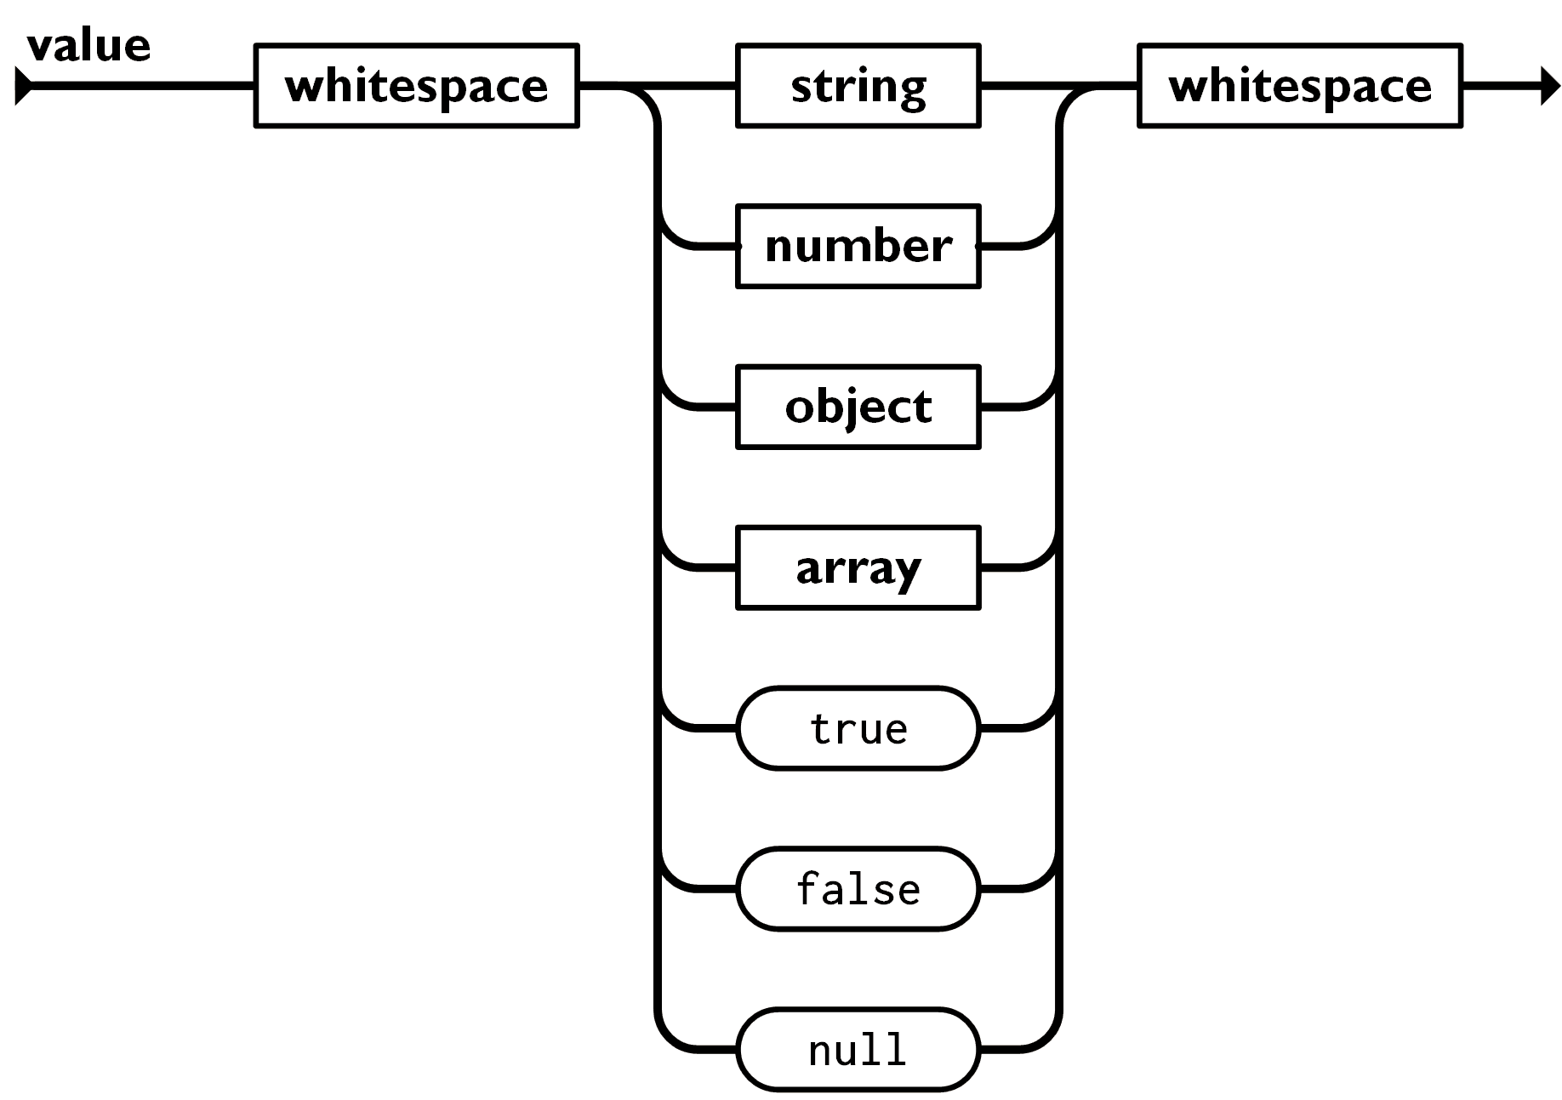
JSON - Value
A value can be a string in double quotes
A value can be a number
A value can be true or false or null
A value can be an object or an array.
These structures can be nested.
https://www.json.org/json-en.html

Slide 13
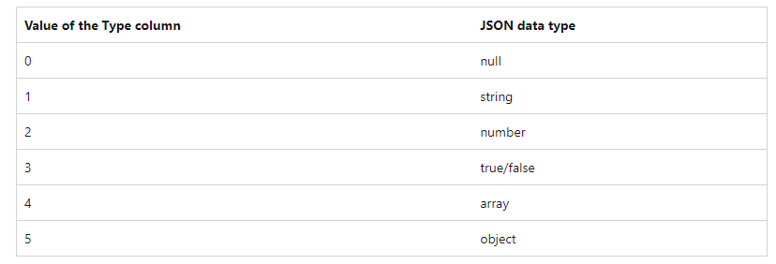
return value types

Slide 14
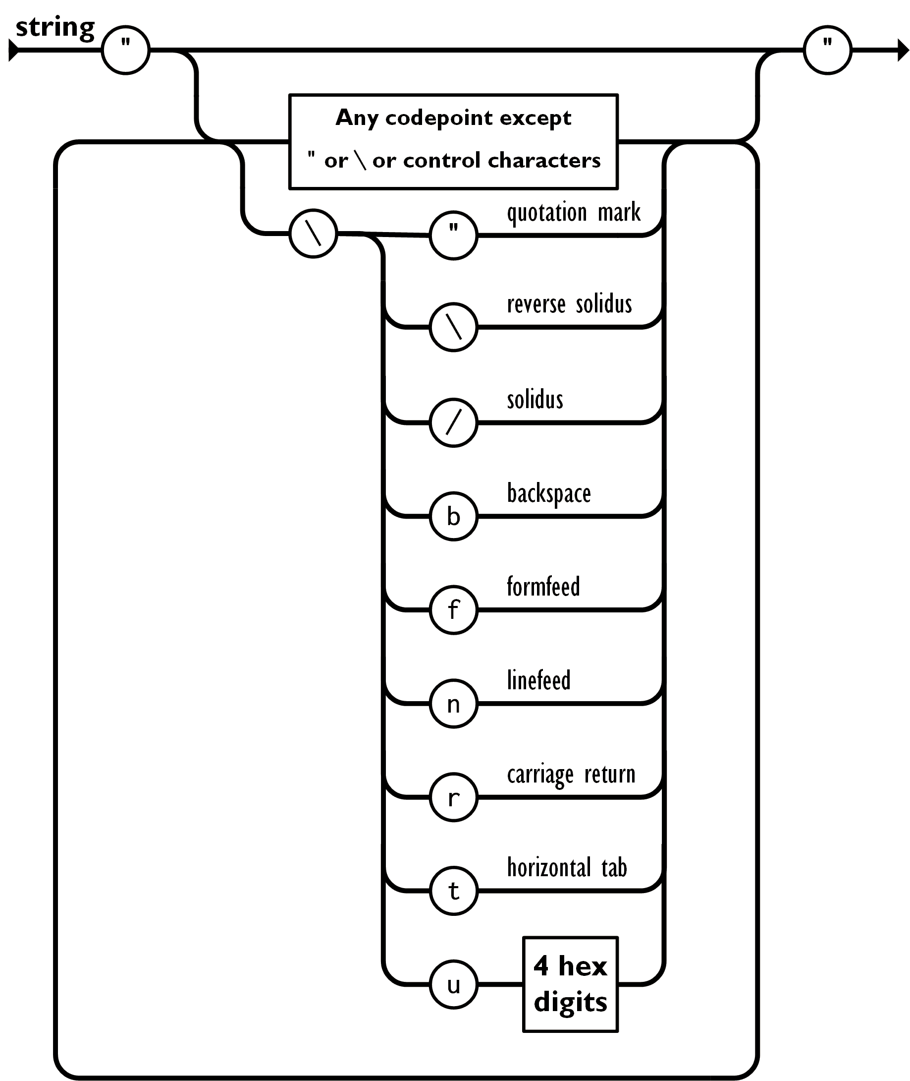
JSON - string
A string is a sequence of zero or more Unicode characters
A string is wrapped in double quotes
A string is using backslash escapes.
A character is represented as a single character string.
https://www.json.org/json-en.html

Slide 15
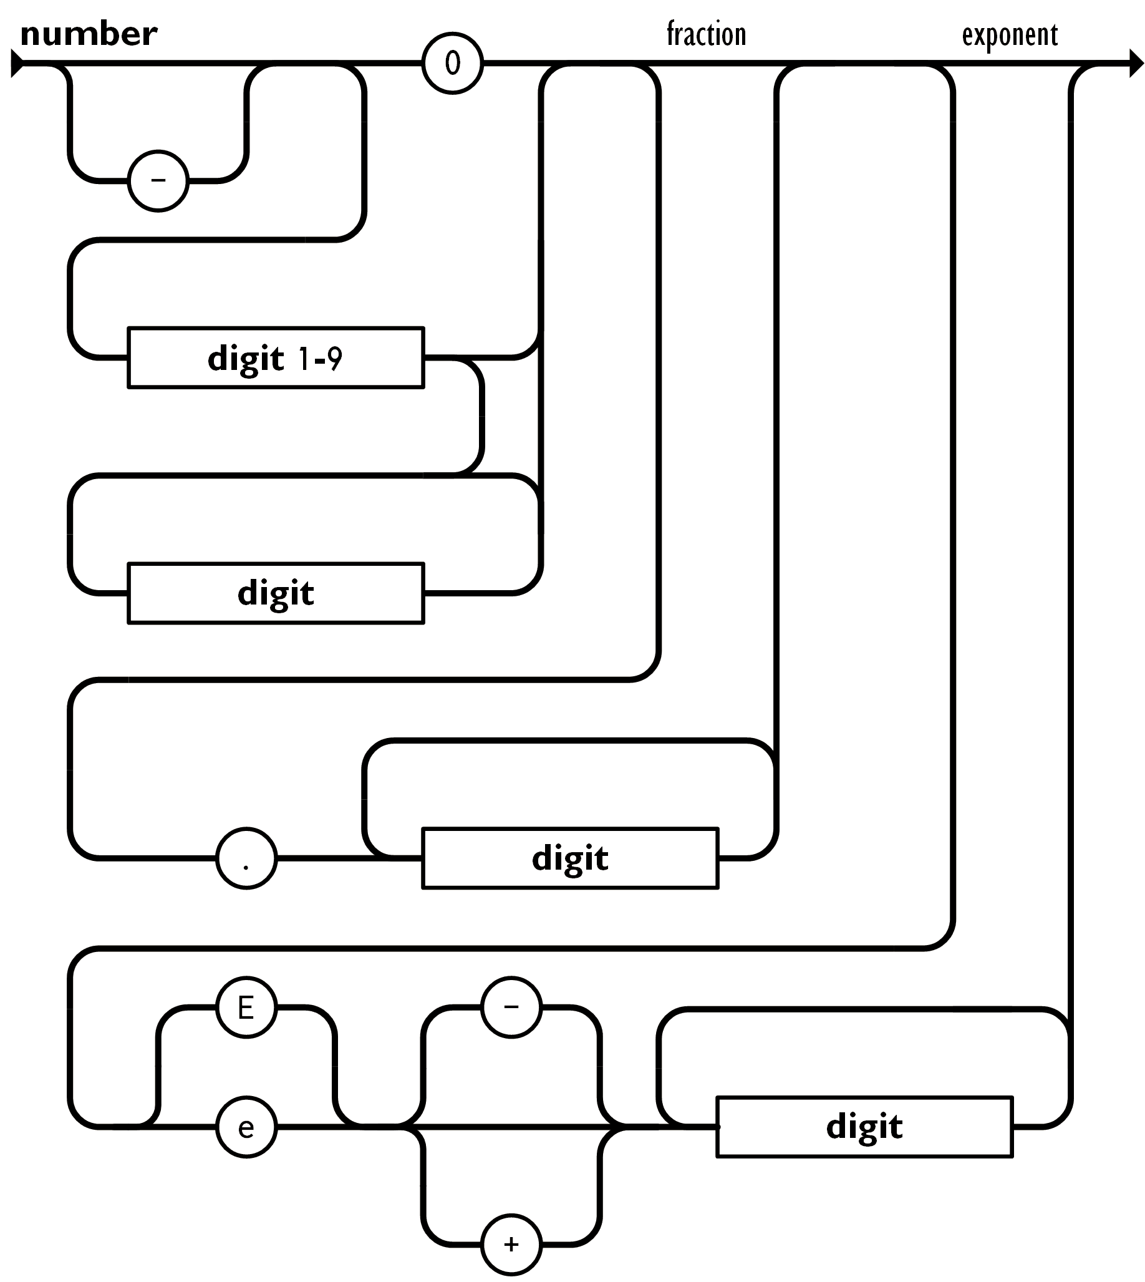
JSON - number
A number is very much like a C or Java number
the octal and hexadecimal formats are not used.
https://www.json.org/json-en.html

Slide 16
Strict vs. Lax modes in JSON
We can use the STRICT and LAX modes when working with JSON data to control how JSON parsing and JSON validation are handled.
STRICT mode
T-SQL enforces strict JSON syntax and validates that the JSON data adheres to the JSON standard. If there are any syntax errors, it will raise an error.
LAX mode
T-SQL is more lenient and allows for some deviations from strict JSON syntax.

Slide 17
JSON functions
control your JSON objects

Slide 18
JSON Functions in Microsoft SQL Server
ISJSON
validate one string argument as the input, it and returns 0 or 1
JSON_VALUE
used to extract a scalar value from a JSON string stored in a database.
JSON_QUERY
used for extracting JSON fragments or sub-objects from a JSON string
OPENJSON
used to transform the JSON string into a relational format
JSON_MODIFY
modify or update values within a JSON string or column.
FOR JSON

Slide 19
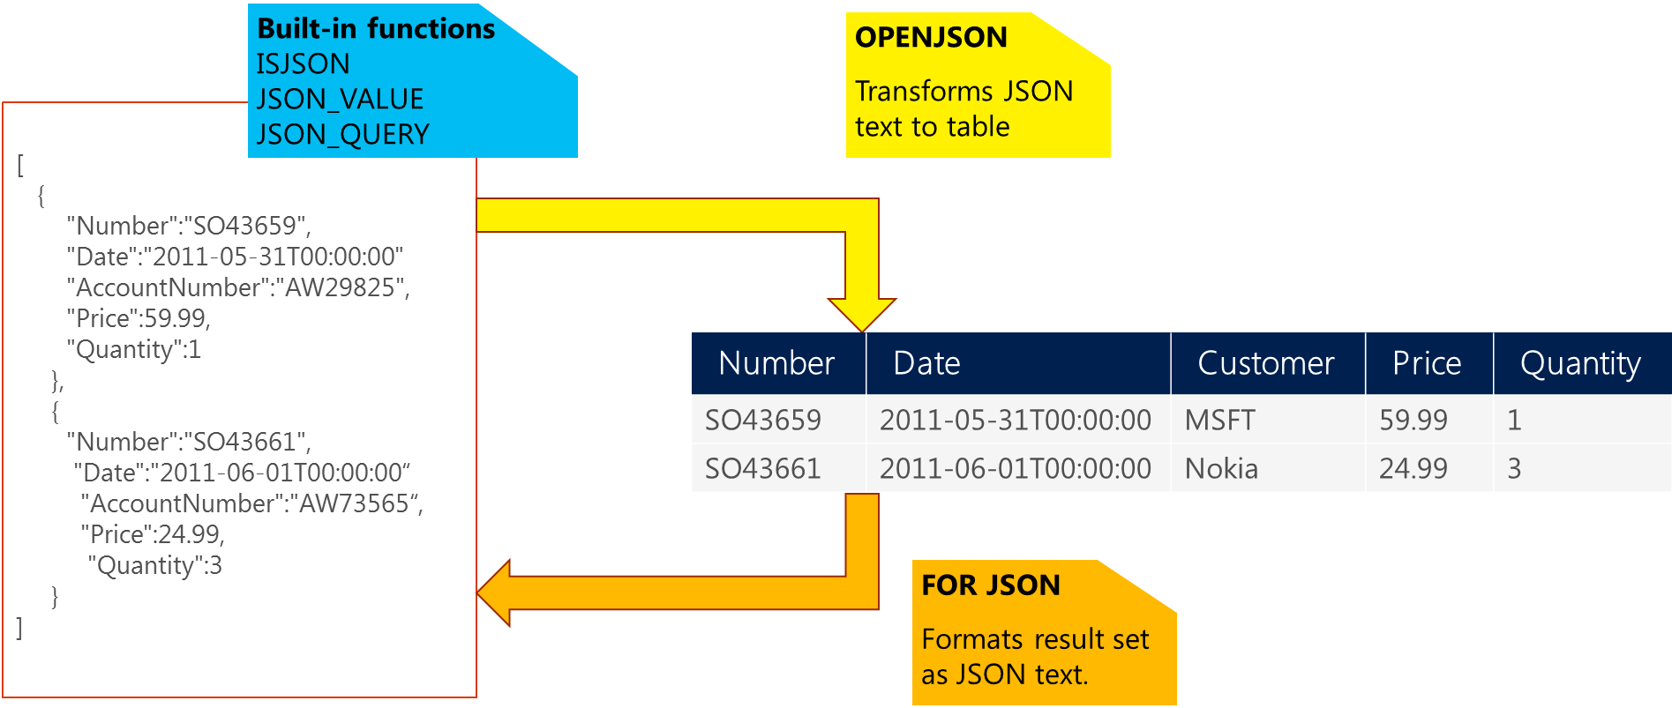
https://cloudblogs.microsoft.com/sqlserver/2016/01/05/json-in-sql-server-2016-part-1-of-4/

Slide 20
T-SQL Function: ISJSON
ISJSON is a T-SQL function used to determine whether a given text is valid JSON.
Syntax: ISJSON(expression);
Returns 1 (valid JSON) or 0 (not valid JSON) or NULL if the expression is NULL.
Common Use Cases:
Validating JSON data before processing.
Filtering out invalid JSON data in queries.
Best Practices:
Always use ISJSON to validate JSON data before working with it to avoid runtime errors.
Notes:
ISJSON checks the JSON format against the JSON standard and is not limited to SQL Server's JSON structure.

Slide 21
T-SQL Function: JSON_VALUE
JSON_VALUE is a T-SQL function for extracting scalar values from JSON data in SQL Server.
It is a valuable tool when working with JSON data, allowing you to access specific values within JSON objects.
Benefits of JSON_VALUE
Extracts specific scalar values such as strings, numbers, and booleans from JSON data.
Allows you to integrate JSON data seamlessly with your relational database.
Use Cases
Retrieving employee names, ages, or any other scalar properties stored as JSON.
Working with JSON data in scenarios like REST API responses or NoSQL data integration.
Conclusion
JSON_VALUE is a powerful function for accessing and manipulating JSON data within SQL Server.
It simplifies the process of extracting specific values from JSON objects, making it a valuable tool in today's data-driven world.

Slide 22
T-SQL Function: JSON_QUERY
JSON_QUERY is a T-SQL function used to extract JSON objects or arrays from a JSON string or JSON column.
Reasons to Use JSON_QUERY:
JSON data often contains nested structures, and you may need to extract a specific object. JSON_QUERY allows you to retrieve JSON objects intact.
When dealing with JSON arrays, JSON_QUERY preserves the array structure and elements, making it ideal for extracting arrays from JSON data.
JSON_QUERY returns the selected JSON data as-is, ensuring that the original structure and data types are preserved.

Slide 23
T-SQL Function: OPENJSON
OPENJSON is a built-in T-SQL function in SQL Server.
It is used to parse JSON data and transform it into tabular format for easy querying.
OPENJSON (jsonExpression [, {jsonPath}])
jsonExpression: The JSON data to be parsed.
jsonPath: Optional parameter specifying the path to the JSON elements you want to extract.
OPENJSON takes a JSON object as input and returns a table with columns for key, value, and type.
It can be used with optional path expressions to filter and extract specific elements from the JSON data.

Slide 24

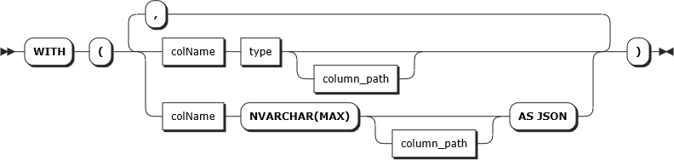
T-SQL Function: OPENJSON
openjson
with-clause

Slide 25
Real World Scenario

Slide 26
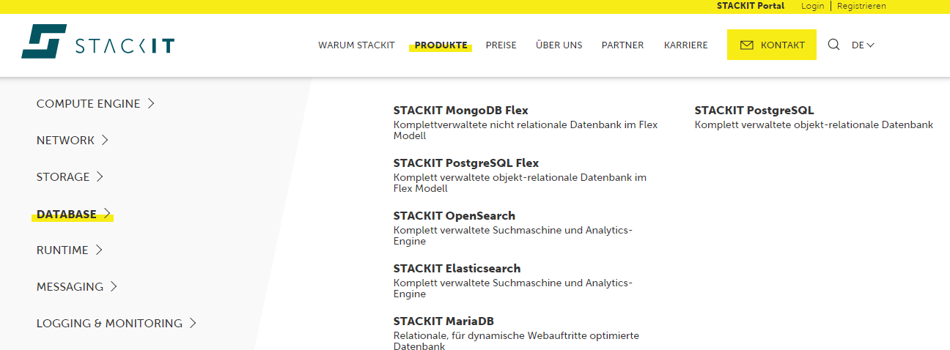
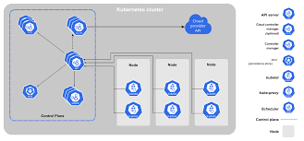
Real World Use Case
API
Kubernets Cluster

Slide 27
Before
CREATE OR ALTER PROCEDURE [system].[create_linked_server] @linked_server_connectionAS NVARCHAR(128), @login_nameAS NVARCHAR(128), @remote_login_nameAS NVARCHAR(128), @access_tokenAS VARBINARY (64), @is_availability_groupAS BIT
AS BEGIN SET NOCOUNT ON;
/* Call of the system routine which process the request! */ DECLARE @return_value INT = 0; DECLARE@logging_guid UNIQUEIDENTIFIER = NEWID();
/* Do some codings...*/
exitcode:
SELECT * FROM logging.logactivity WHERE logging_guid = @logging_guid;
RETURN @return_value;
END
Setup
Stored Procedures with variables
Invoked by „named parameters“
Predefinition of data types
Complex documentation
Problem
New variables in Stored Procedures requires a redesign of the API endpoint definition
Only both (API / Stored Procedure) modules must be updated at the same time

Slide 28
After
CREATE OR ALTER PROCEDURE [system].[create_linked_server] @input_variableNVARCHAR(MAX), @output_variableNVARCHAR(MAX) OUTPUT AS BEGIN SET NOCOUNT ON; DECLARE @return_value INT = 0;
SELECT linked_server_name, force_dropping, logging_guid
FROM OPENJSON (@input_variable) WITH ( linked_server_name NVARCHAR(128), force_dropping INT, logging_guid UNIQUEIDENTIFIER );
/* Do some codings here */
exitcode: RETURN@return_value; END
Setup
Stored Procedures with variables
Invoked by „named parameters“
Predefinition of data types
Complex documentation
Problem
New variables in Stored Procedures requires a redesign of the API endpoint definition
Only both (API / Stored Procedure) modules must be updated at the same time

Slide 29
THANK YOU…

